Slide 1
Alphabet Soup! Evidence-Based School Improvement Practices That Work!
  Mr. Casey L. Sovo
  Education Program Administrator
  Belcourt Education Resource Center

Slide 2

MISSION
The mission of the BIE is to provide students at BIE-funded schools with a culturally relevant, high-quality education that prepares students with the knowledge, skills, and behaviors needed to flourish in the opportunities of tomorrow, become healthy and successful individuals, and lead their communities and sovereign nations to a thriving future that preserves their unique cultural identities.

Slide 5

2020 - 2024

Slide 6
BRAVERY
RESPECT
HONESTY
7 Teachings
Realigned in Spring 2022
As a cooperative PK-12 school system spread out over six campuses with 2,200 students and 560 staff members, administrators collectively chose to return to cultural knowledge, skills, and abilities to drive all of our school improvement efforts
LOVE
HUMILITY
WISDOM
TRUTH

Slide 7

2
WISDOM
We turned to ourselves for the answers. We had been very successful in the past during Reading First and BIE Reads using Direct Instruction (RM, CR, L4L, L4W) and other scripted programs (Rewards, Rewards Plus, Language Live) to help students learn to read by closing the gaps.

Slide 8
Reading First, BIE Reads!, and Math Counts
Put section info here
COMMUNICATIONS
Goals
Core Reading
Programs
Differentiated
Instruction
Instructional
Time
Put section info here
Put section info here
Assessment System
Data Mngmt & Use
Put section info here
Put section info here
State Leadership
Leadership
& Coaching
Professional
Development
Technical
Assistance
Evaluation & Accountability

Slide 9

BIE Reading First/BIE READS! vs. All Other BIE Schools
3rd Grade Proficiency on State Assessments
Reading First +
BIE READS! Schools
All Other BIE Schools

Slide 10
2
LOVE
To teach effectively is an act of love. To use student data proficiently is a demonstration of love. We knew our staff members were committed to their students and their community so their professional actions as educators proved love to be a verb.

Slide 11
Reduced Special Education Referrals
Turtle Mountain Elementary School | Assessed for Special Ed | Provided Special Ed
Pre-RF 03-04 | 52 | 31
Yr 1 04-05 | 31 | 13
Yr 2 05-06 | 13 | 4
Yr 3 06-07 | 4 | 2

Slide 12
2
RESPECT
We struggled with the student data collected the year immediately after COVID-19: reading, ELA, mathematics, behavior, SEL, and absenteeism. The reality of unfinished learning was harsh and daunting. Students were at least 2 years below grade level expectations, and some HAD NEVER been in a school building before the 2nd grade.

Slide 13
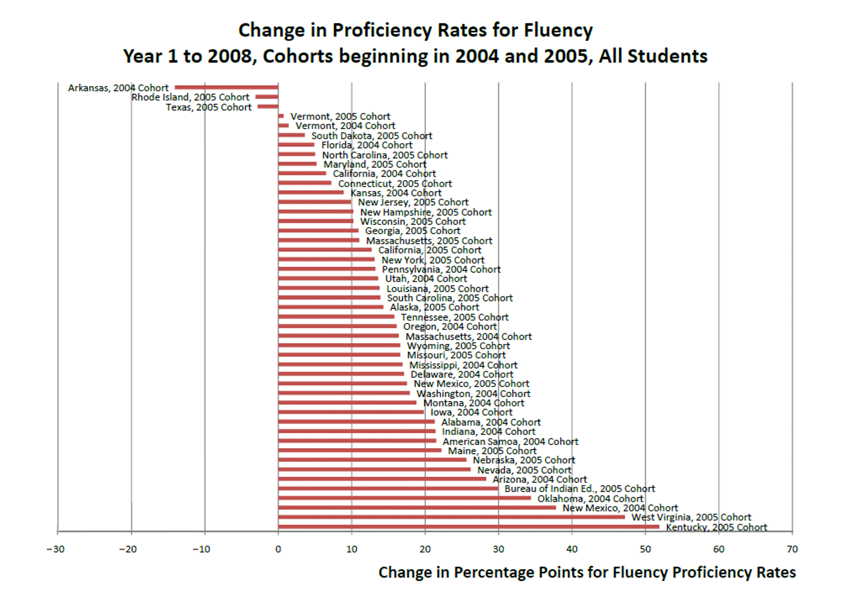

U.S. Department
of Education
BIE: 5th Greatest Gain in Reading Fluency

Slide 14
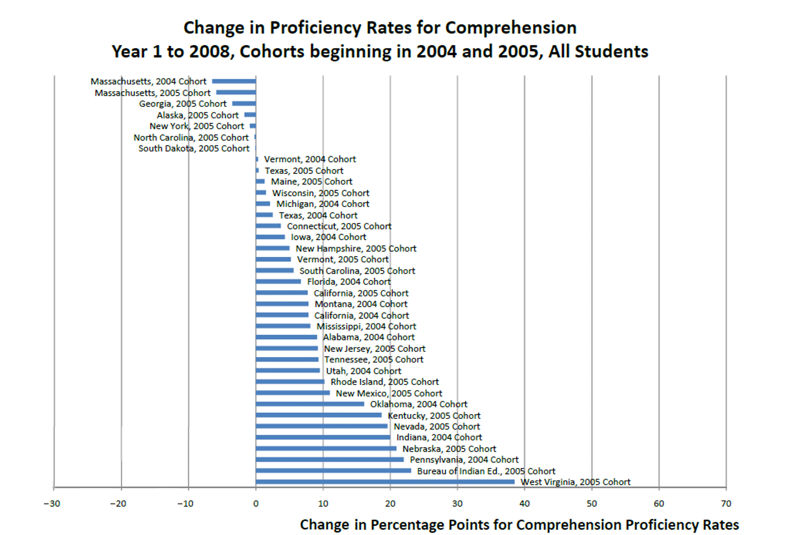
U.S. Department
of Education
BIE: 2nd Greatest Gain
in Comprehension
Proficiency

Slide 15
2
BRAVERY
Our first steps in the right direction were the scariest steps. We were scared to fail, afraid to make mistakes, worried we would lose even more ground, and concerned that teaching staff would hate the new direction: MTSS for ALL. But we had to focus on the immediate learning needs of all our students.

Slide 16
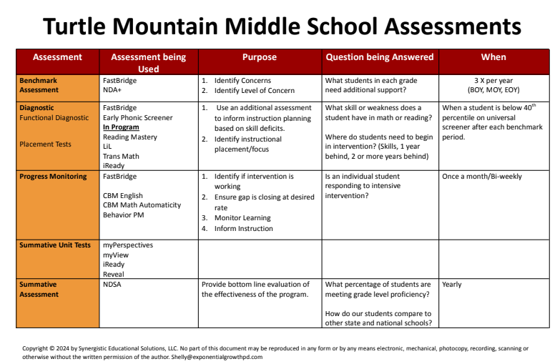

Slide 17
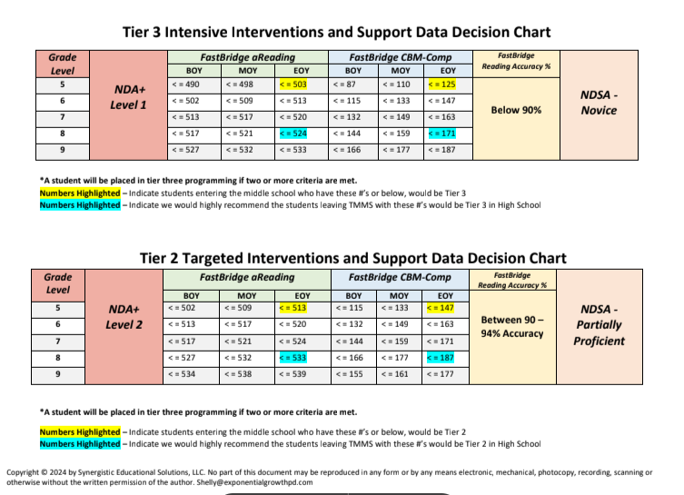
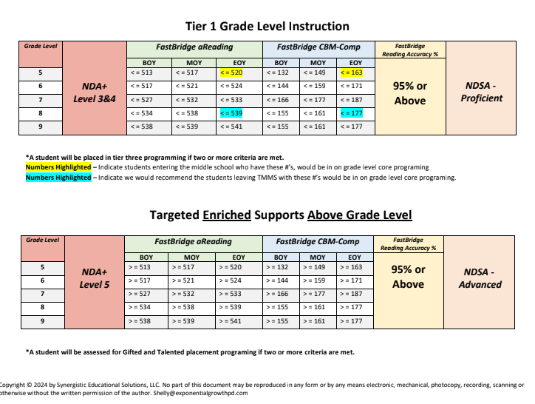
Multiple Data Point Decision Making

Slide 18
2
HONESTY
We knew our MTSS methodology was contrary to the majority. We knew that our chosen path would be challenging for teachers, paraprofessionals, instructional coaches, and principals. We knew we could re-master the KSA’s and return to a state of effectiveness, efficiency, and mastery through practice and effort.

Slide 19
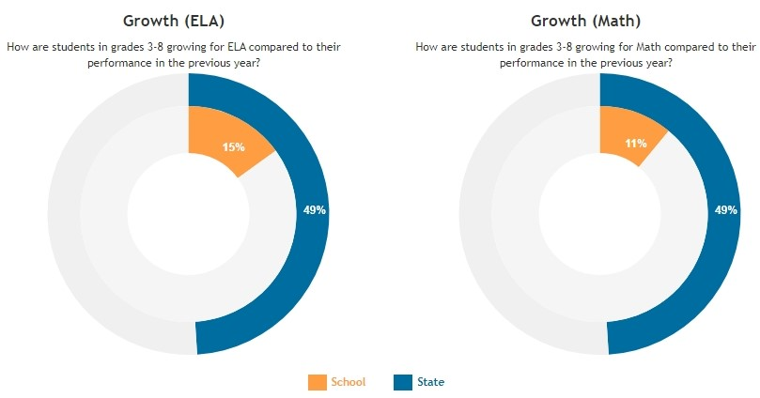
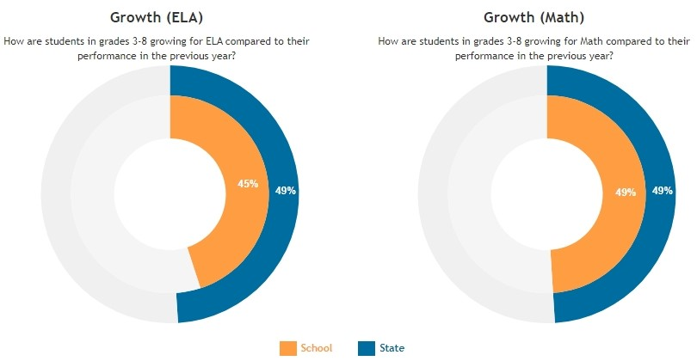
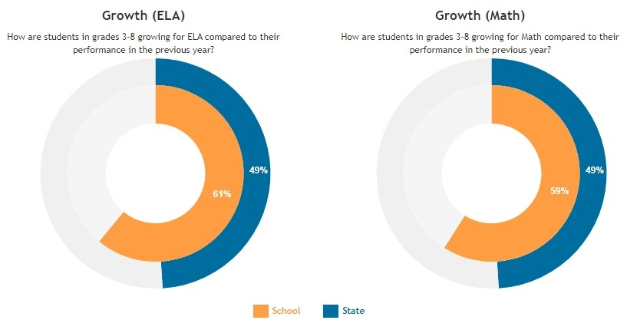
TMES Growth
2020-2021
2021-2022
2022-2023

Slide 20
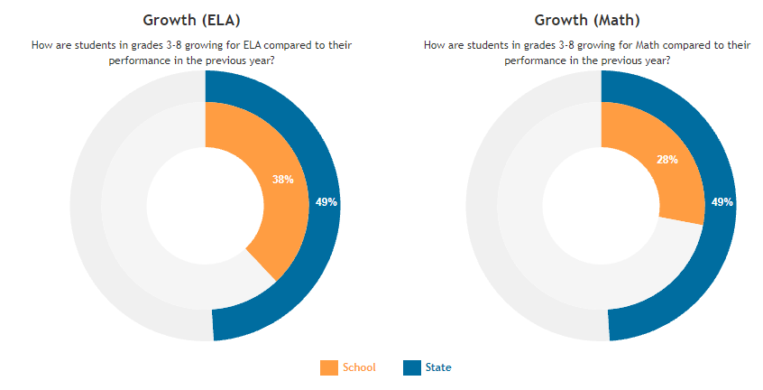
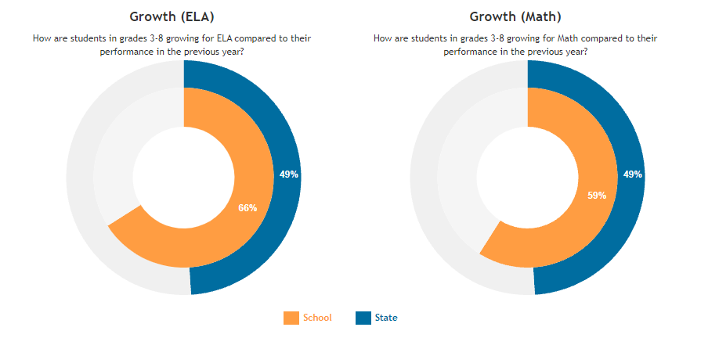
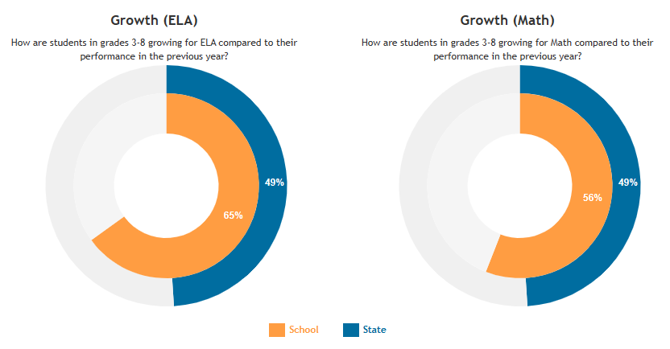
TMMS Growth
2020-2021
2021-2022
2022- 2023

Slide 21
2
HUMILITY
We knew we did not have ALL OF THE ANSWERS or ALL OF THE TOOLS, but we had enough drive and ambition to cover the gaps. WE ARE THE ONES OUR ANCESTORS DREAMED ABOUT AND PRAYED FOR. WE ARE TASKED WITH DOING THE WORK, using our skills for today’s children, and ensuring the success of tomorrow’s sovereign nations.

Slide 22
Do Not Accept the Status Quo!
We must be willing to challenge old habits and beliefs
Students can read, but
they can’t comprehend
These assessments don’t measure the right thing
These programs don’t work for….
Achievement
hasn’t improved fast enough
We are ignoring language & culture

Slide 23
2
TRUTH
We knew we were starting from behind. Our student achievement scores were abysmal. Student and staff attendance were problematic. The learning curves for program knowledge and implementation fidelity were almost straight up. Yet, we knew we could accomplish our goals if we made data-driven decisions and worked together.

Slide 24
I Do…
We Do…
You Do…
ARE Indigenous!

Slide 25
DDS Achievement

Slide 26
OIS Achievement

Slide 27
TMES Achievement

Slide 28
TMMS Achievement

Slide 29
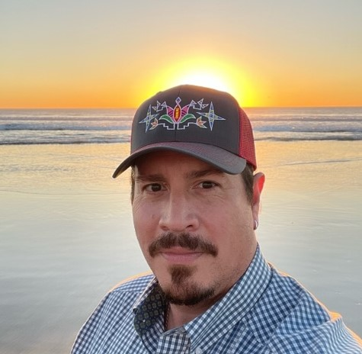
Contact Info:
  Casey Sovo
  Education Program Administrator
  Belcourt Education Resource Center
  Casey.Sovo@bie.edu
  701-550-7025

Slide 31
CONNECT WITH US!
www.bie.edu
@BureauIndEdu
/BureauofIndianEducation
@BureauofIndianEducation
/Bureau-of-Indian-Education

